Slide 1
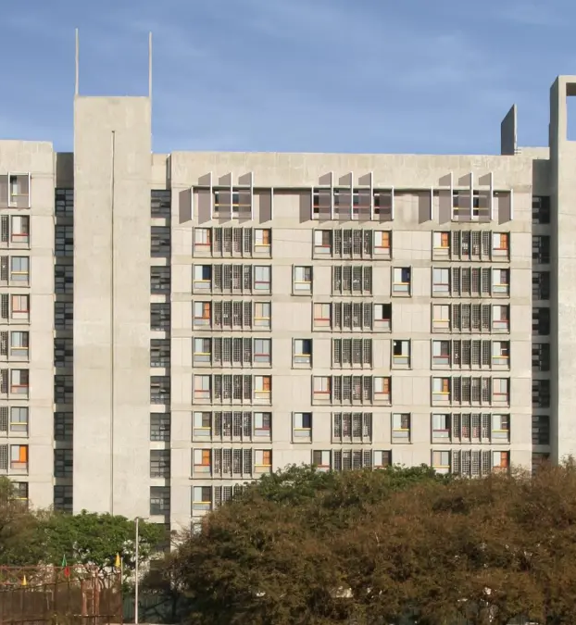
HOSTEL MANAGEMET
Unraveling Accommodation Administration

Slide 2
System Workflow Overview :
Hostel Management System
Room Allocation & Management
Administrative Control Actions
Administrative Control Actions
Effective Roommate and Room Matching Based on Preferences
Room Availability Viewing
Student Check-In/Check-Out Monitoring
Seamless Maintenance Inquiries and Requests Processing
Reservation Requests and Stay History Tracking
Administration of Student Records and Occupancy Reports

Slide 3

OUR TEAM :
TEAM NAME :
Sumit Girnar [B.TECH,COMP,612203055]
Aditya Gund [S.Y,COMP,612203061]
Avadhoot Ghewade [S.Y,COMP,612203057]
Pradnyesh Mate [S.Y,COMP,61220311 ]
Om Kendre [T.Y,COMP,6122030 ]
ANOYMOUS [S.Y,COMP,6122030 ]
Thanks!
youremail@freepik.com
+91 620 421 838
yourwebsite.com

